Slide 1
Medicine Delivery Robot
Kevin Blount
Anthony Dietz
Brock Stechschulte

Slide 2
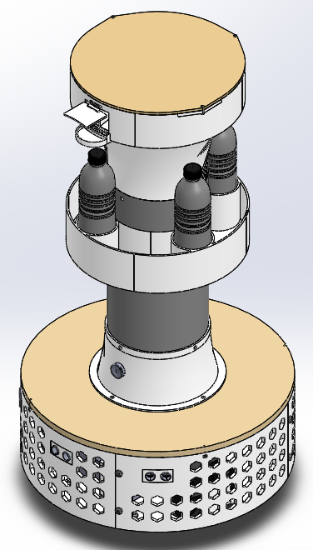
Problem Statement:
For our project we are tackling the problem of how hard it is for senior citizens receive their medications in their own home. To resolve this problem, we are creating The Medicine Delivery Robot. This robot will deliver a person’s medicine to them wherever they are in their home.

Slide 3
Areas of Research
Looked at robotic systems used both in the hospital, and systems used commercially in other areas of our daily lives
Current technologies show that we are moving towards more sophisticated robotic devices
These devices are able to navigate complex, sometimes unpredictable, floor plans
Hospital building with multiple levels with different layouts

Slide 4
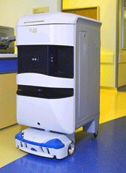
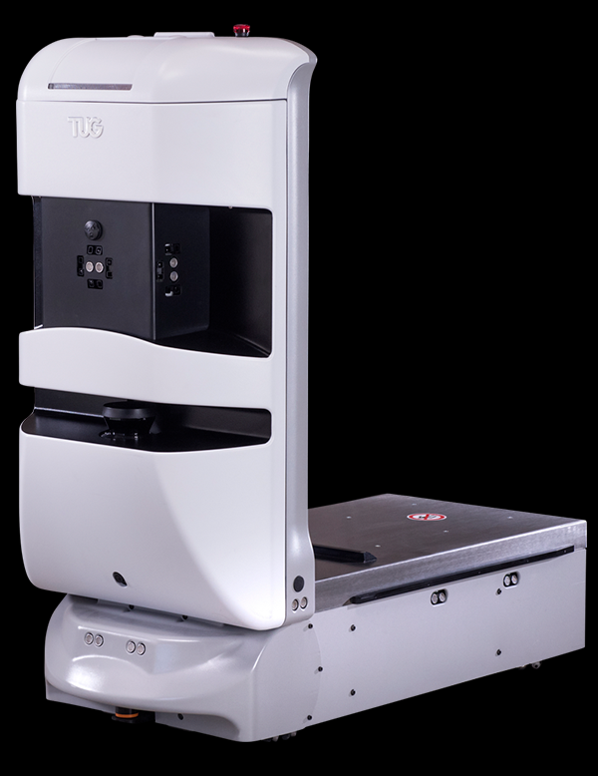
Tug
Developed by Aethon
Fully autonomous hospital robot
Delivers food and medicine to different parts of the hospital
Uses LiDAR sensors to create 3D map of its surroundings
Comes in different variants:
T3, T3XL, The Drawer
Can be monitored all around the world by Aethon’s control centers
Max Payload: Depends on variation, starts at 1,000 lbs
Battery Life: 10 hrs

Slide 5
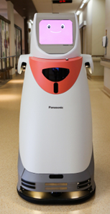
Hospi
Being developed in Japan
Comes pre programmed with map of the hospital
Uses this information along with Ultrasonic sensors to navigate
Features onboard security
Need a key card to access the contents that you ordered
Max payload: 45lbs
Battery Life: 9 hrs

Slide 6
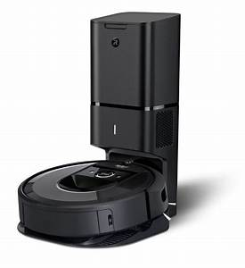
Roomba
The roomba is the most used household robot on the market today.
This robot can navigate a home and maneuver around obstacles to complete its task.
This robot is small and compact and returns to the charging station located in the house.

Slide 7
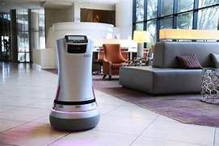
Relay Robot
This robot was developed by the company Savioke.
This Robot has the capability to securely deliver food medicine or groceries to people in need.
These robots can be found in hotels, hospitals and other crowded areas
Very secure so items do not get stolen on the way

Slide 8
End User
So who would be most likely to use our product?
We are targeting those who have a difficult time moving around their homes or who have trouble remembering to take their medication
Currently, the number of skilled nursing homes are on a decline in the US (20% less by 2020)
This means that more and more people who need help, aren’t getting it
Hard for caregivers (nurses and family members) to keep up with needs

Slide 9
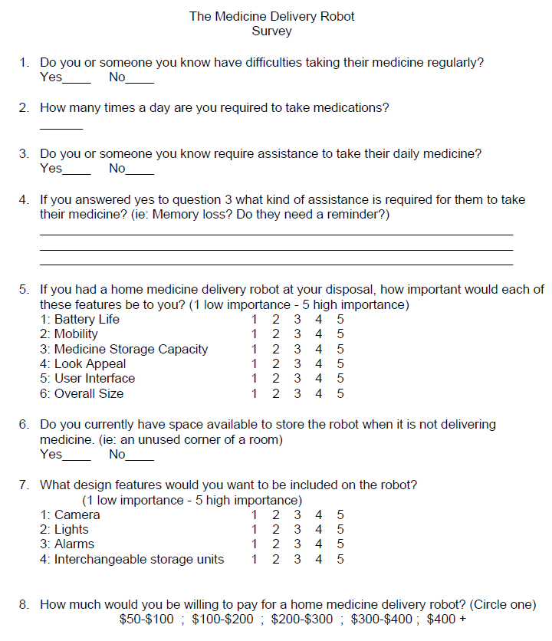
Sample Survey

Slide 10
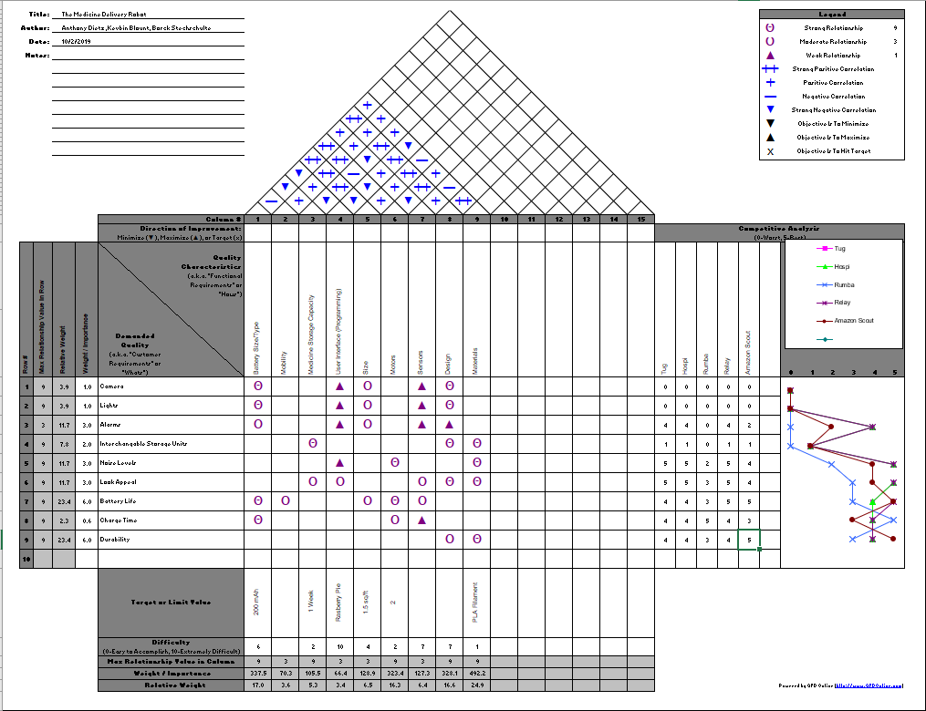
House of Quality (HoQ)

Slide 11
Survey & HoQ Results
Engineering Characteristics
User Interface (4.7)
Mobility (4.1)
Battery Life & Storage (3.9)
Overall Size (3.7)
Appeal (3.6)
Relative Weighting
Battery Size/Type - 17.0%
Mobility- 3.6%
Medicine Storage Capacity- 3.4%
User interface- 3.4%
Size- 6.5%
Motors - 16.3%
Sensors - 6.4%
Design - 16.6%
Materials - 24.9%
Customer Features
Alarms (4.33)
Lights (4.00)
Interchangeable Storage Units (3.48)
Camera (3.41)

Slide 12
What we need to build
A robot that can navigate a person's home to bring them medication
Sensors that allow it to sense objects in its path (ie. Clothes, box, etc.)
Needs an alarm to alert user of its presence or any problems
Must be at average waist height so user doesn’t have to bend down
Intuitive interface that can be easily navigated
Mobility and battery life that allows this to not be an inconvenience
The overall look was not a big issue, convenience outweighs appeal
A camera was not deemed necessary in the initial design.
Can be integrated into future products

Slide 13
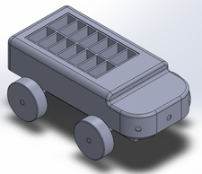
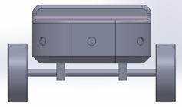
Design Concept 1
Car design. Could be wheeled or tracked
Pros:
More agile (able to climb over objects)
Less likely to get hung up on clutter (clothes, small objects)
Lighter, needs less power
Cons:
Short (user would have to bend over)
If wheeled, would have a larger turn radius

Slide 14
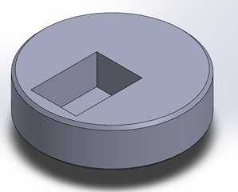
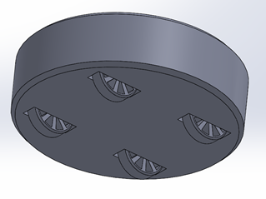
Design Concept 2
Short disk (think roomba)
Pros:
Compact
Less expensive
Cons:
User has to bend down to retrieve their medicine
Limited features

Slide 15
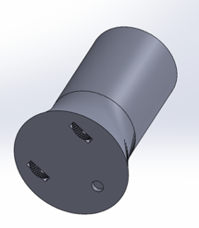
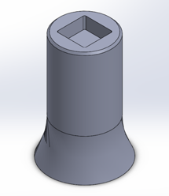
Design Concept 3
Tower concept with two wheels to drive the robot, swivel caster in the rear for stability
Pros:
Can reach waist height easily
Storage compartment is within arms reach
Cons:
Higher center of gravity
Takes up more space

Slide 16
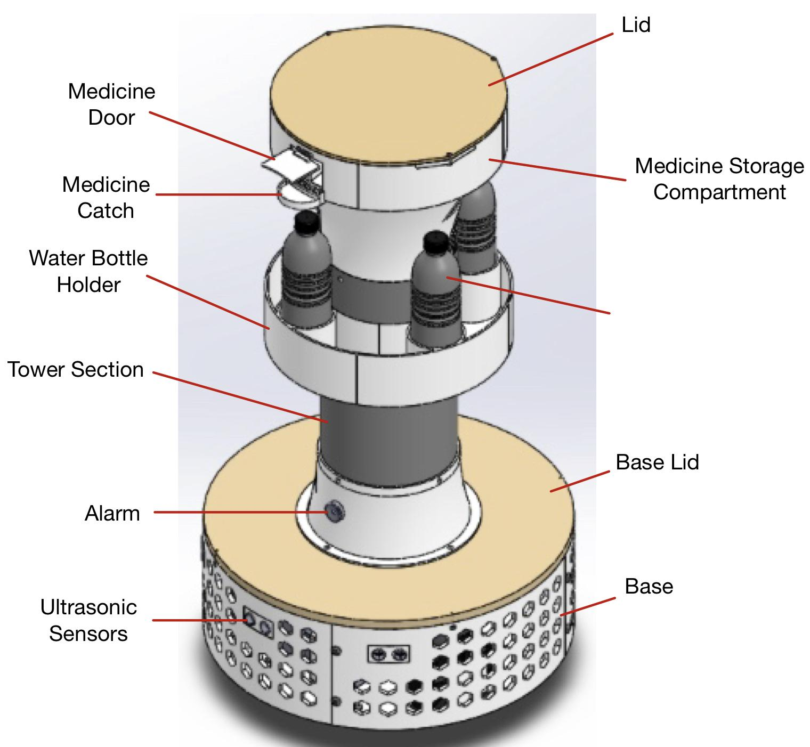
Final Design
Went with tower design
Allows more space for features
Alarm
Sensors
Indexing storage
Water bottle storage

Slide 17
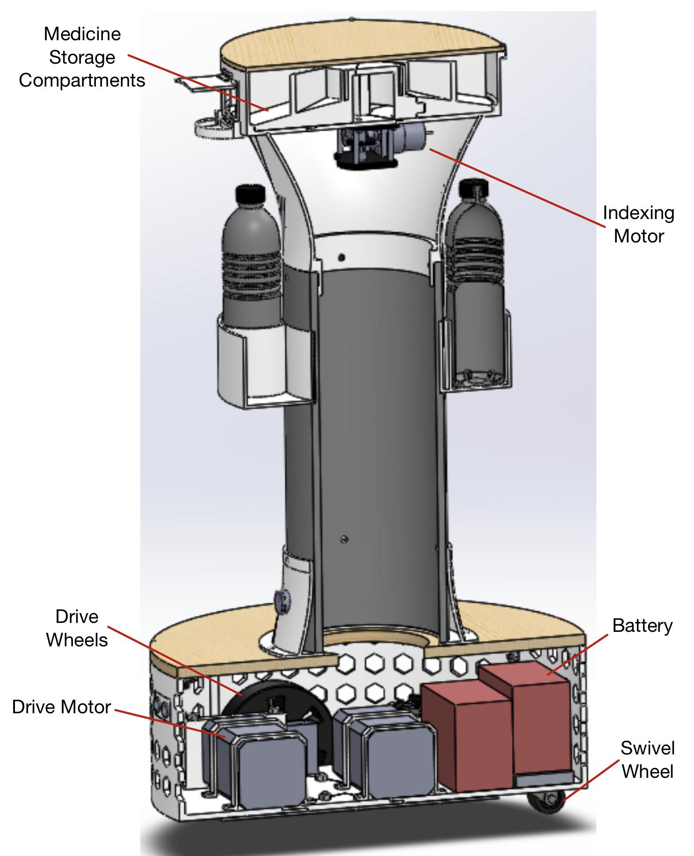
Final Design Sectioned
Placed motors, battery, and CPU in base to lower center of gravity
Material
ABS plastic
PVC piping
Baltic Birch wood

Slide 18
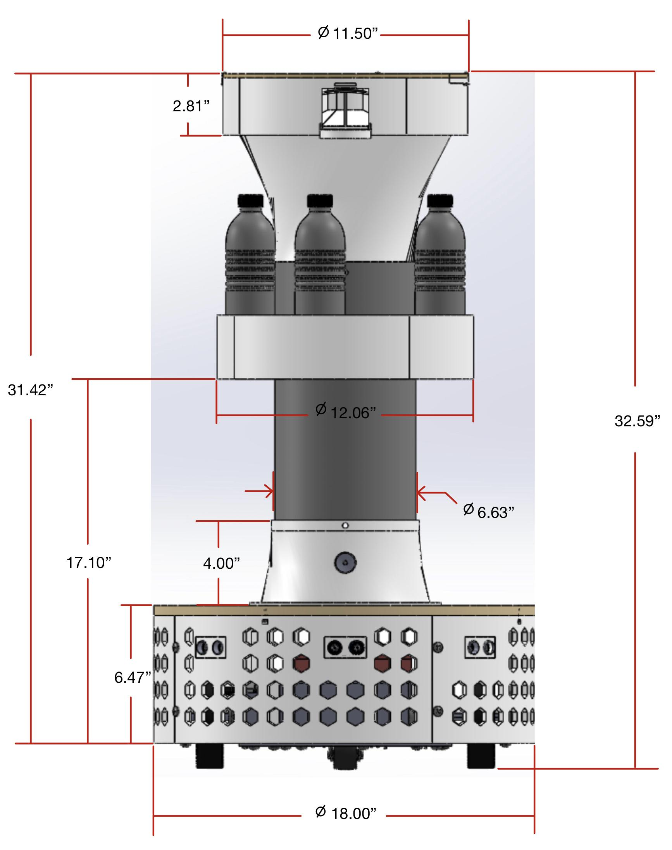
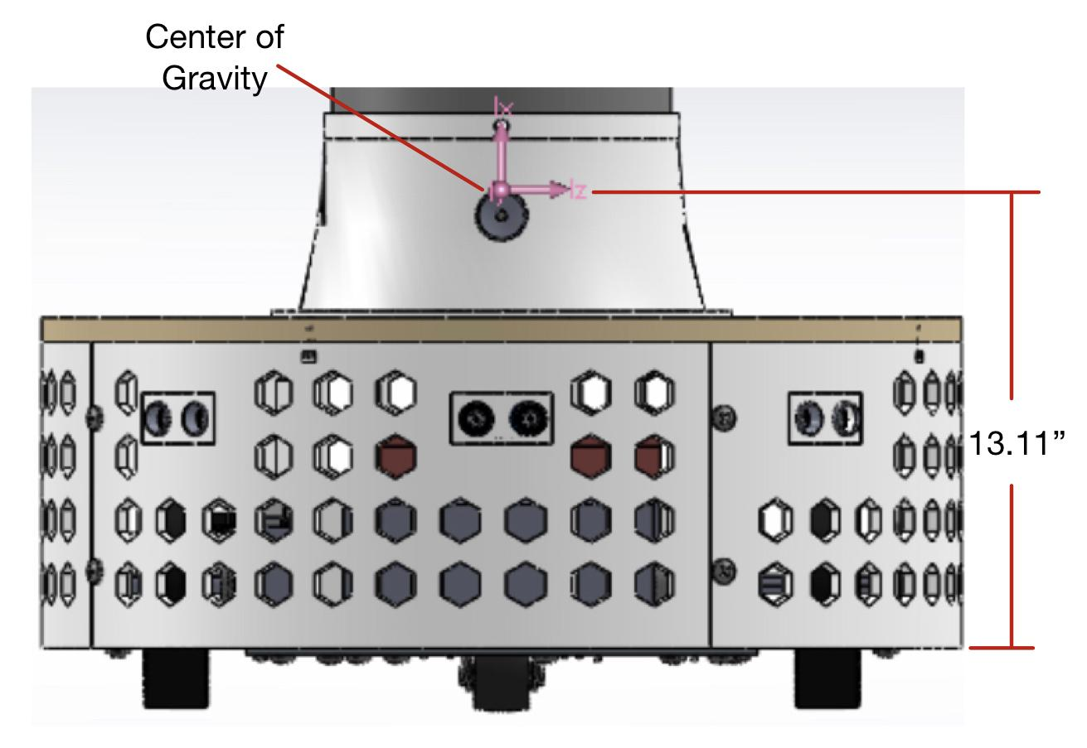
Final Design Dimensions
Weight (only ABS): 12.96 lbs
Total Weight: 36 lbs

Slide 19
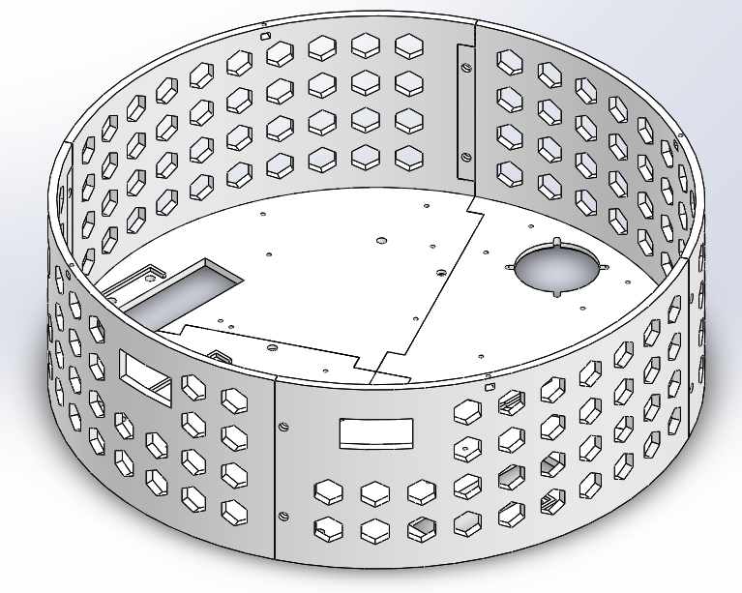
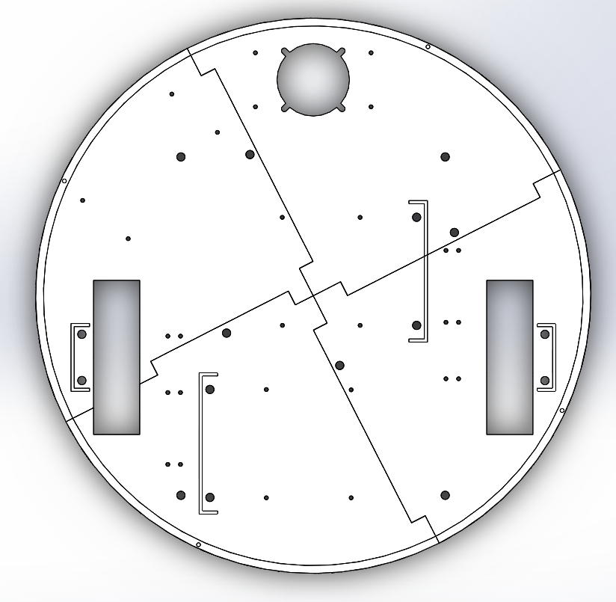
Drive Base Design
Features Hexagon holes in wall
Saves weight
Air flow for cooling
Cut out sections for wheels
2 five inch slots for wheel
1 cut out section for swivel wheel
Hole locations
Raspberry pi 3B+ Standoffs
Motor mounts
Axle Mounts
Gearbox mount
Swivel wheel mounts

Slide 20
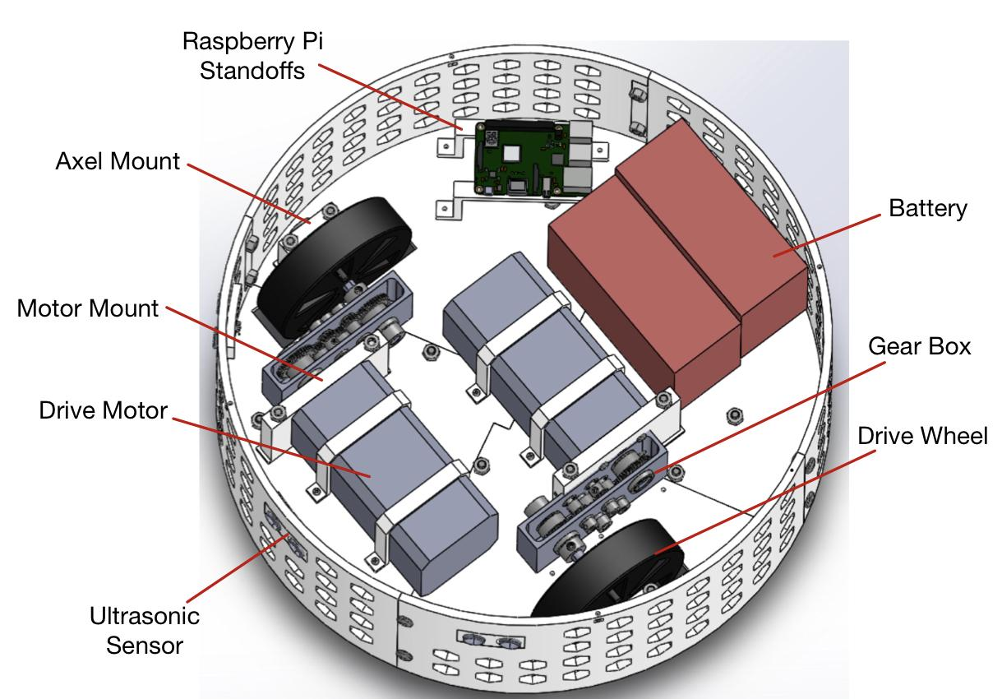
Drive Base Design With Motors and Sensors

Slide 21
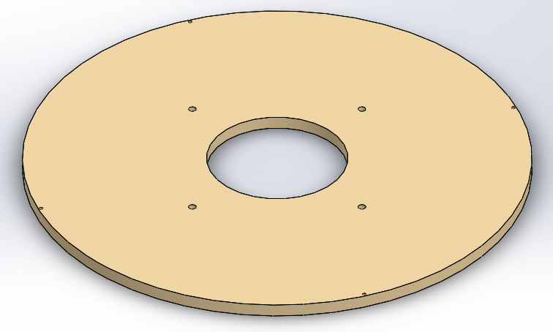
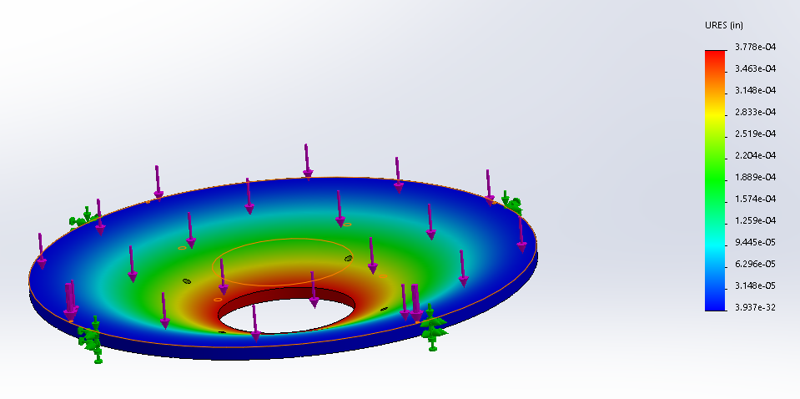
Base` Lid Design
0.472 in thick - 13.68 lb*f applied - Max Deflection .0004in

Slide 22
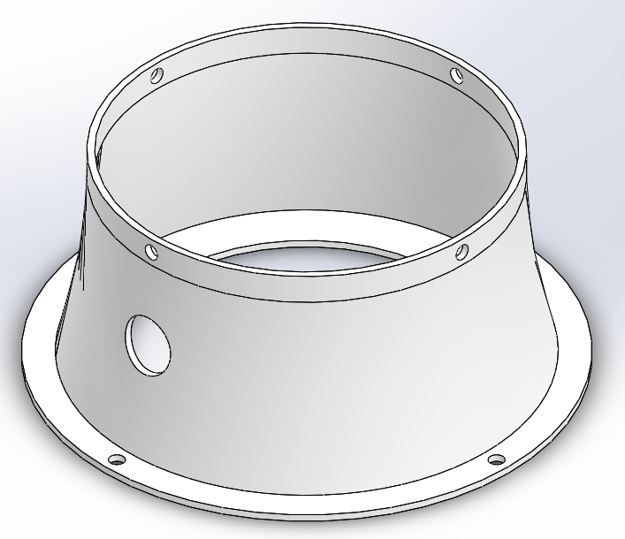
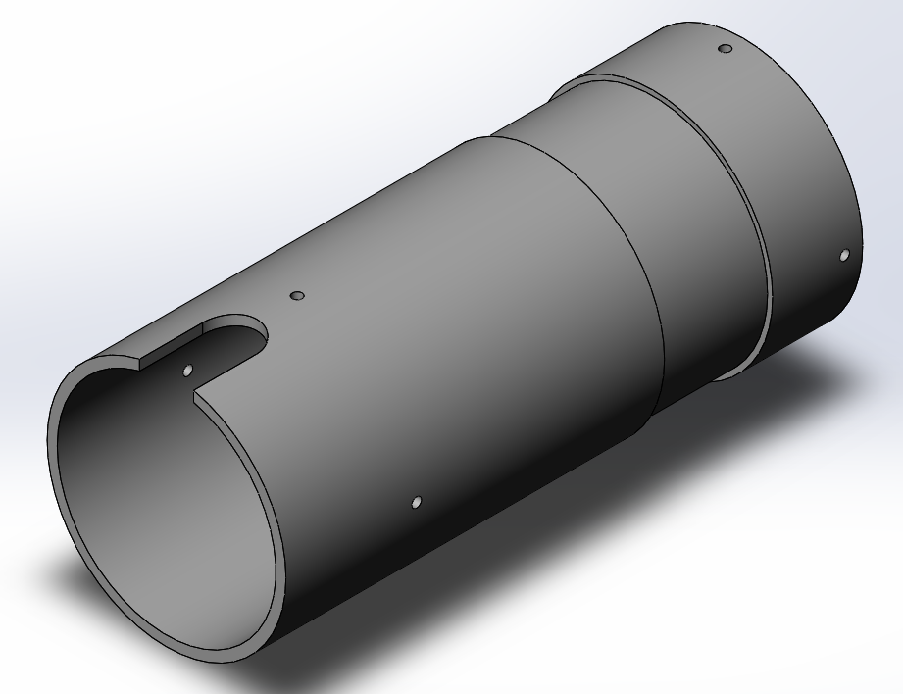
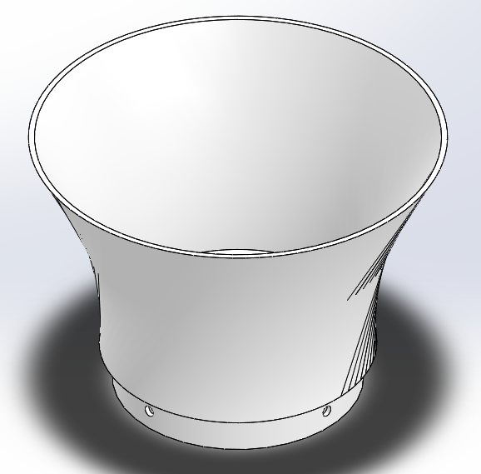
Tower Designs
Lid / Alarm Tower
Middle Tower
Upper Tower

Slide 23
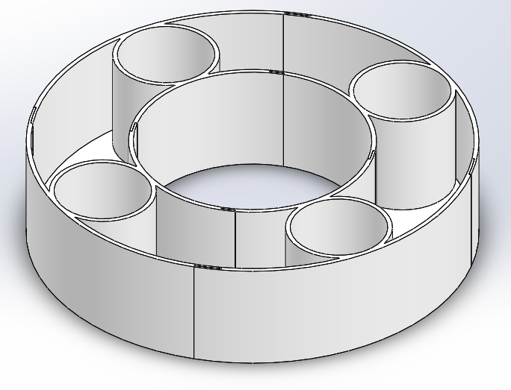
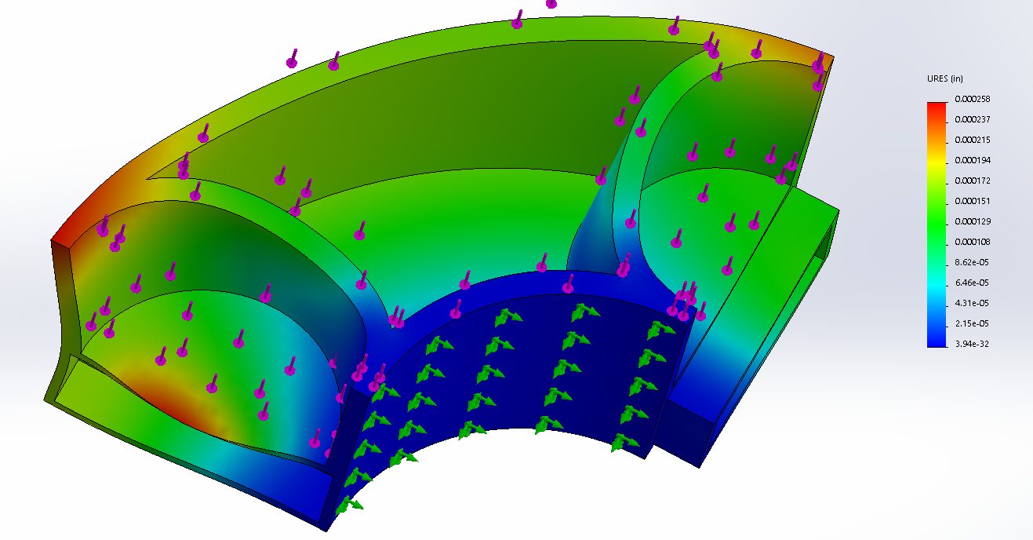
Drink Holder Design
1.39lb*f
.46 lb*f per cup holder
Max Deflection .000258 in

Slide 24
3D Printing
Printing out of the Digital Fabrication Lab @ Victory Parkway Campus, University of Cincinnati
Great quality with their prints
Better prices compared to 1819 Innovation Center

Slide 25
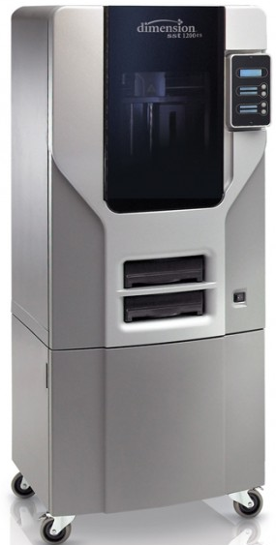
3D Printer
Using the SST 1200es series printer
FDM Printer
Prints ABS plastic
Build Tray Size: 254 x 254 x 305 mm (10 x 10 x 12 in)
Layer Resolution: 0.254 mm (0.010 in)

Slide 26
Order of Printing
Print the Drive Base and Indexing components first
Connected to motors
Most crucial, Other sections can be printed as we wire/code the motors

Slide 27
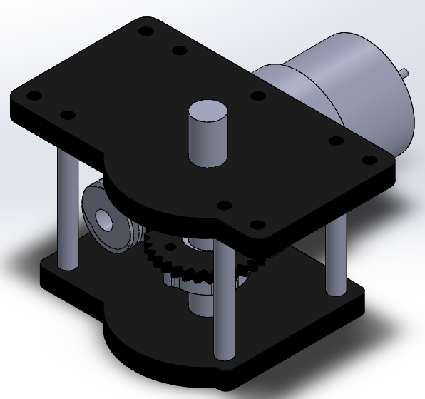
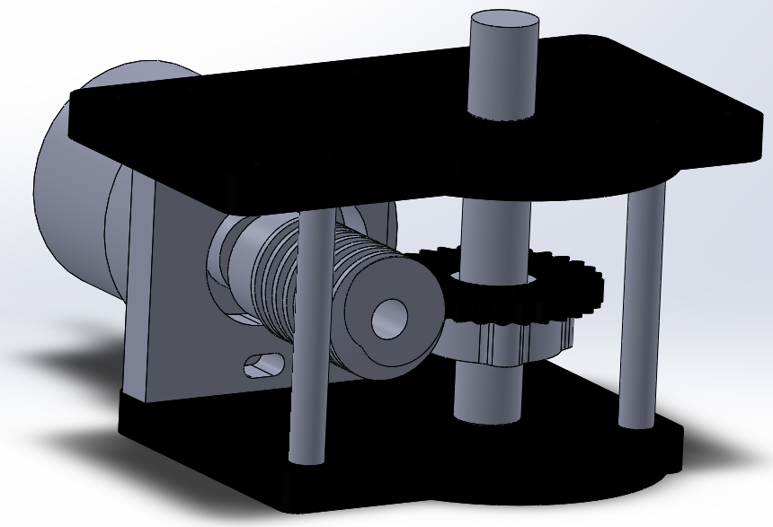
Indexing Mechanism
Gearing:
Has a 30:1 gear reduction
Uses a standard vertical gear attached to a horizontal worm gear
Motor:
Powered by 12V motor
200 rpm (no load)
~7 rpm with reduction
Has an encoder shaft in order to track the rotations

Slide 28
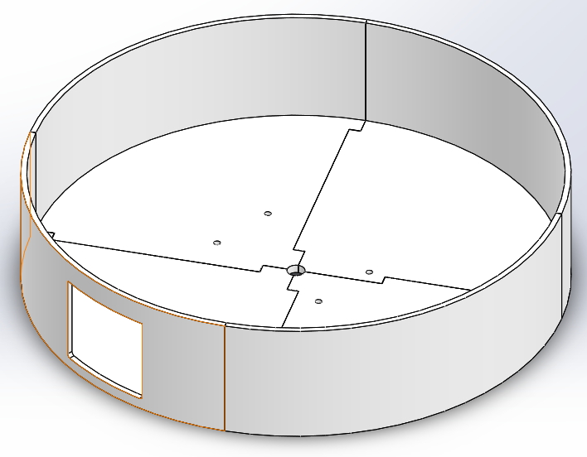
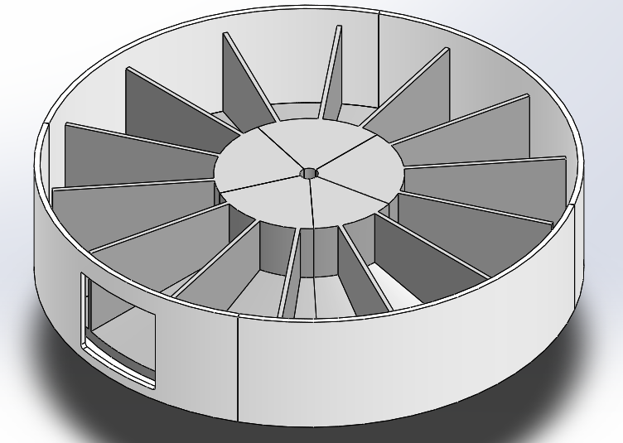
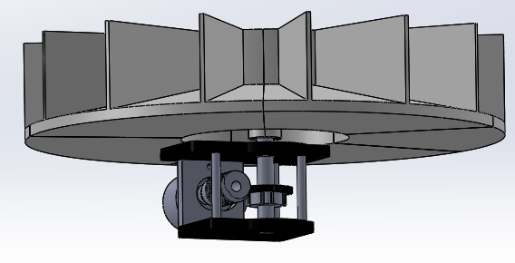
Medicine Storage
Circular indexing storage compartment
Indexes each time a new set of medication is ready

Slide 29
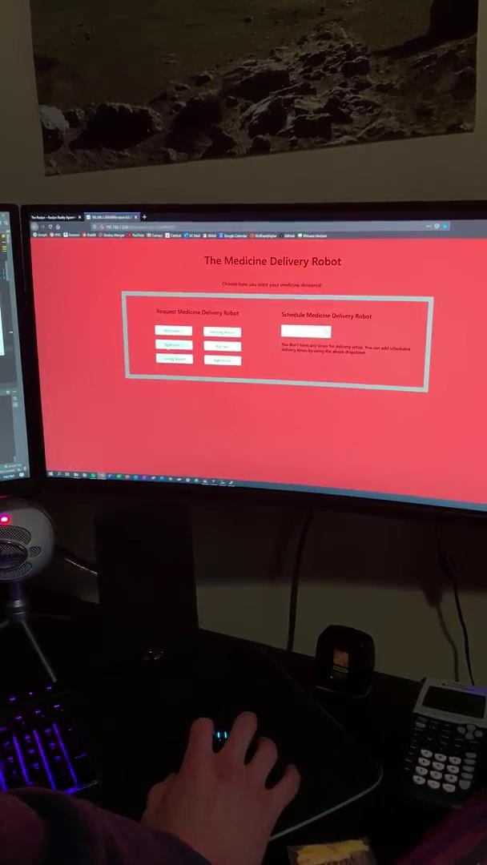
Indexing Motor Testing

Slide 30
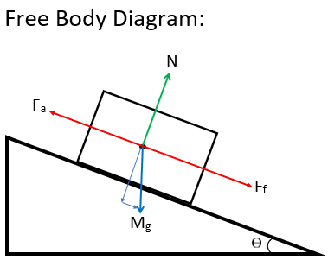
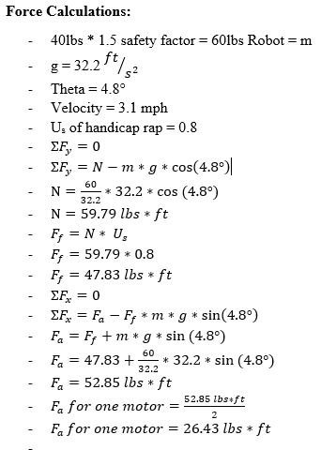
Force Calculations
Desired Speed 3.1mph (Standard Walking)
Total weight of robot 40lbs
Safety factor 1.5
Safety factor weight 60 lbs
Incline 4.8° (maximum wheelchair incline)
Coefficient of friction = 0.8 (Grip material for handicap ramps)
Fa = Force applied to get robot up ramp
Fa = 26.43 * 2 motors = 52.86 lbs*ft

Slide 31
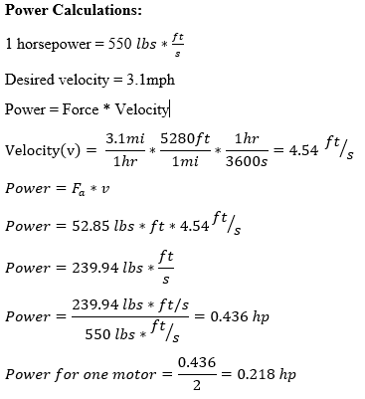
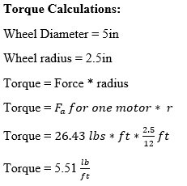
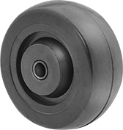
Power and Torque Calculations
Power Calculation for One Motor:
Power = Force * Velocity
Force = Fa = 26.43 lbs*ft
Velocity = 4.54 ft/s
Power = 119.97 lbs*ft/s
Power = 0.218Hp
Torque Calculation for one wheel:
Torque = Force * radius
Radius = 2.5in
Force = 26.43 lb*ft
Torque = (26.43)*(2.5/12) = 5. 51 lb*ft

Slide 32
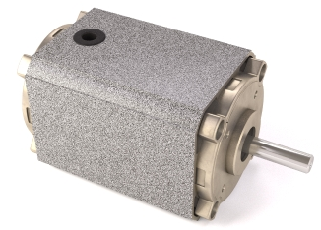
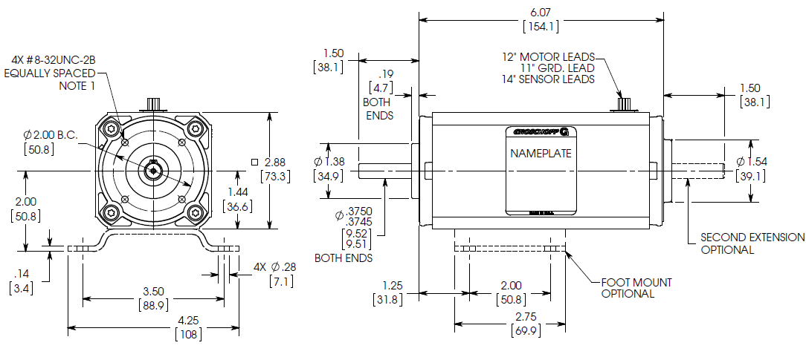
Motor Selection
Groschopp 24V DC Brushless Motor 7122
Speed: 2,900 rpm
Torque: 4.4 in-lb (70.4in-oz)
Power: 0.2 hp
Will use encoder for positioning feedback
This motor is compact while delivering more than the required power needed!

Slide 33
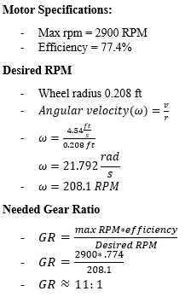
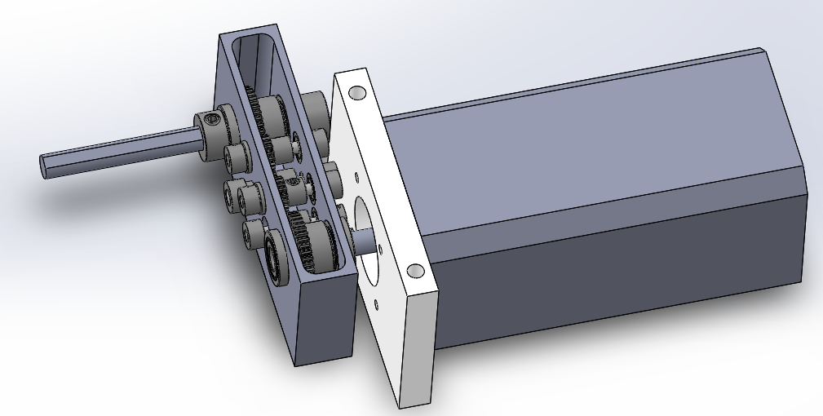
Gear Train Calculations and Selection

Slide 34
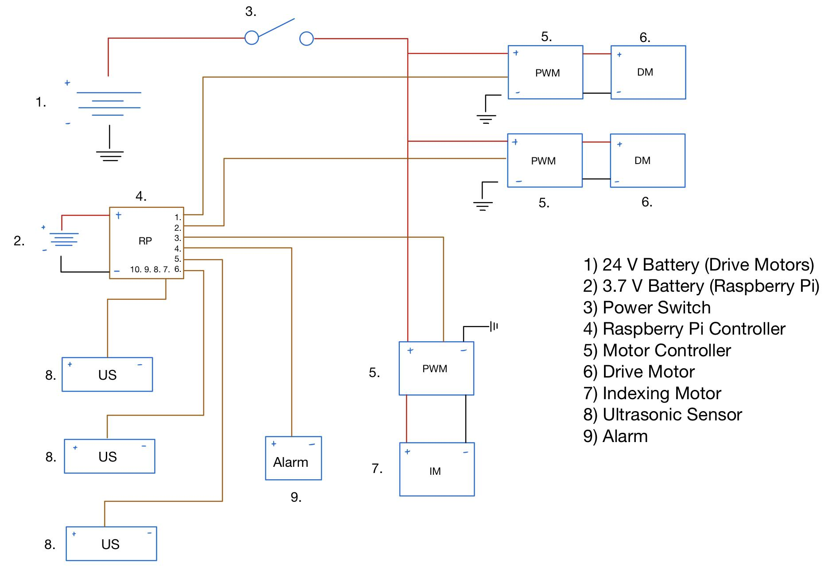
Circuit
Diagram

Slide 35
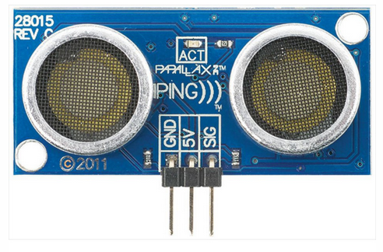
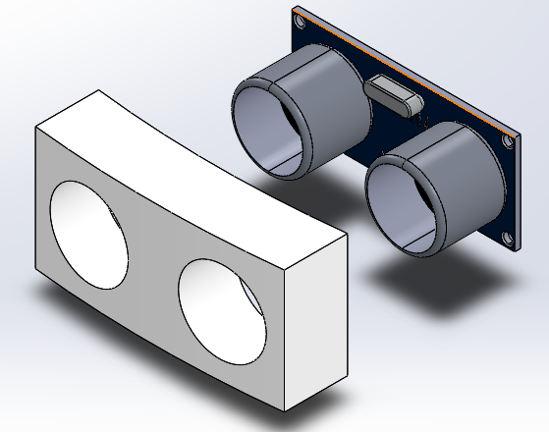
Ultrasonic Sensors
Parallax PING Ultrasonic Sensor
20mA
Total of 3 Sensors:
1 Mounted straight ahead
2 Mounted at 45 degrees
Sensing range of 2 cm - 3m

Slide 36
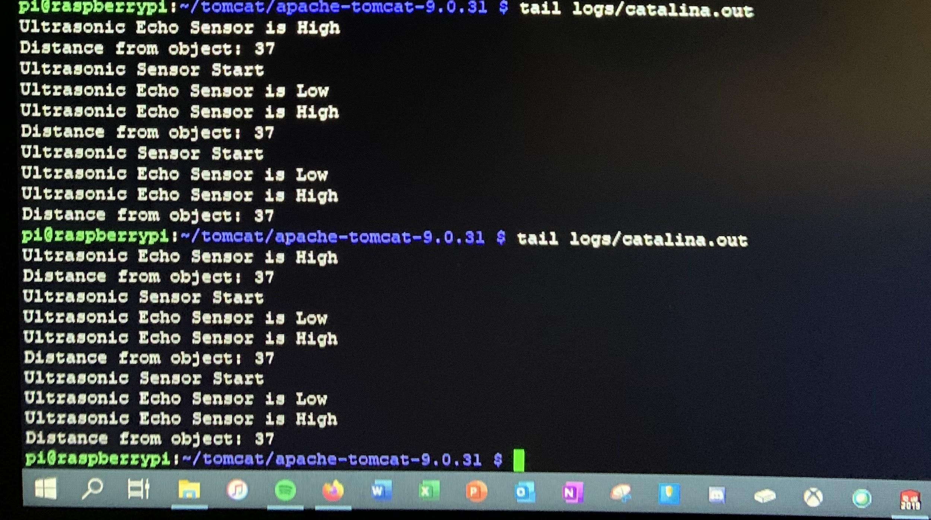
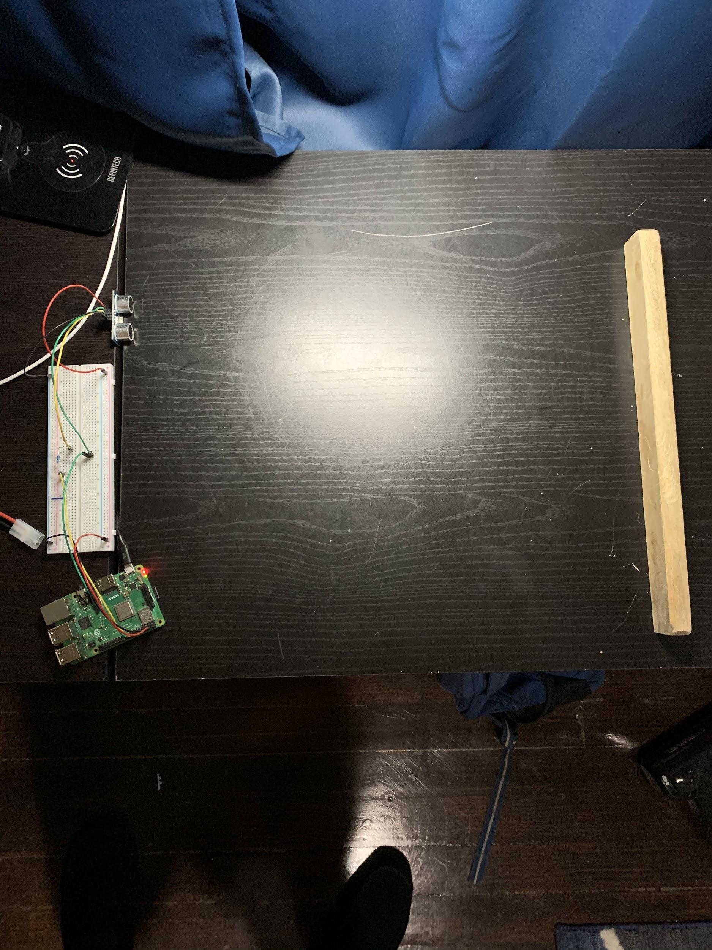
Ultrasonic Sensors Testing (Object Far)
When an object is far enough away that it won’t interfere with the robot, the sensors simply record its distance and the robot continues on its path

Slide 37
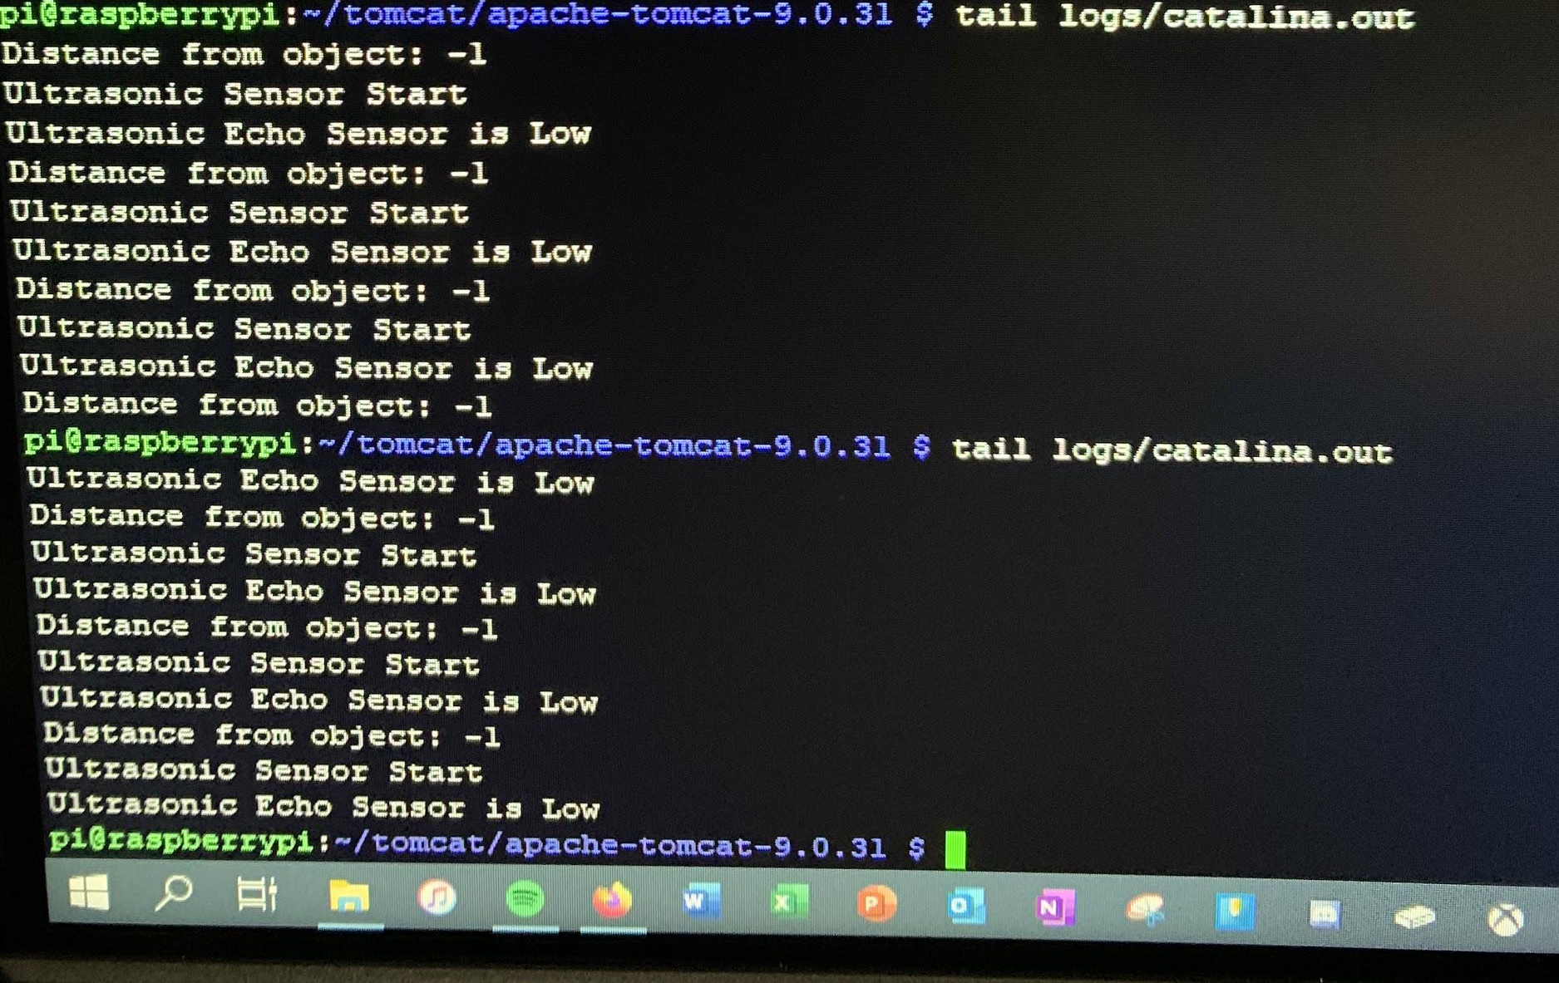

Ultrasonic Sensors Testing (Object Near)
When an object gets too close to the robot, they read a -1 value and show a “Low” warning. This tells the robot that it is about to collide with an object and needs to stop and swivel around the object in order to complete it’s path

Slide 38

Alarm
Large Piezo Alarm
2-18 V dc
No resistor
Puts out 100 dB @ 3KHz
Equivalent to average motorcycle
Alerts user when it arrives with medicine
If it becomes stuck
Whatever assistance it needs

Slide 39




Battery Selection
Two 12 volt 9 Ah batteries wired in series to get the desired voltage for the drive motors
One 12 volt 2 amp battery pack to meet the requirement to power the indexing motor

Slide 40





Development
At its core, the Medicine Delivery Robot is controlled by a Raspberry Pi. When powered on, the Raspberry Pi deploys the web application which allows the user to start the medicine delivery process. It also controls the motors, sensors, alarm, and medicine dispensing mechanism.

Slide 41

Raspberry Pi 3B+ Control Board
1.4GHz 64-bit quad core processor
The brains of our robot
5V & 2.5A DC power input
Will receive power from separate batteries
Micro SD card to load our programs
Programmed using Java

Slide 42

User Interface

Slide 43
How it works
Connect the Robot to your Wifi
Go to the IP address connected to the robot
Set up delivery time and medicine

Slide 44

How it works
If you do not have any times scheduled, it will show a message saying:
“You don’t have any times for delivery setup. You can schedule delivery times using the above option”

Slide 45

Delivery of Medicine

Slide 46

Animation of Robot

Slide 47



Budget
Total Amount
: $3,861.33 or $1,287.11 per teammate

Slide 48
Final Results
Accomplished
Creating a unique design which accommodates all end user’s demands.
Development and wiring of the hardware items (index motor, sensors, alarms) to the Raspberry Pi.
Creating a user interface that is deployed when the robot is powered on.
Partial construction of our robot’s base and medicine dispenser.
Unable to complete
However, due to COVID-19, we were not able to complete the construction of our robot. Many of the parts that we required were not able to be 3D printed with 3D print labs shutting down. We also weren’t able to cut our PVC pipe and lids to fit our robot. Finally, we were unable to order our motor controllers as they were from China and could not be delivered.

Slide 49
Future Implementations
Complete the construction of the medicine delivery robot.
Improvements to the design of the web application.
Create automated message system to notify care takers when they need to refill the medicine dispenser.
Add new features such as Camera, AI system, and a locator device

Slide 50
Citations
1. Samadi, David D. History and the future of Robotic Surgery. Robotic Oncology. [Online] [Cited: Sep 05, 2019.] https://www.roboticoncology.com/history-of-robotic-surgery/.
2. Tug, the Busy Little Robot Nurse, Will See You Now. Wired. [Online] May 25, 2018. [Cited: Sep 05, 2019.] https://www.wired.com/story/tug-the-busy-little-robot-nurse-will-see-you-now/.
3. The TUG Autonomous Robot. Aethon. [Online] [Cited: Sep 05, 2019.] https://aethon.com/mobile-robots-for-healthcare/.
4. Panasonic Autonomous Delivery Robots - HOSPI - Aid hospital Operations at Changi General Hospital. Panasonic Newsroom. [Online] Panasonic Corporation, Jul 23, 2015. [Cited: Sep 05, 2019.] https://news.panasonic.com/global/topics/2015/44009.html.
5. Hospi. Wikipedia. [Online] Aug 16, 2019. [Cited: Sep 05, 2019.] https://en.wikipedia.org/wiki/Hospi.

